Slide 1
LOOPS
Present To:
Mr. NITURA, JASON
Present BY:
JUSAYAN, JUVELYN S.
BSIT-2A

Slide 2
Loops in PHP -are used to execute the same block of code a specified number of times.

Slide 3
PHP supports following four loop types.
for − loops through a block of code a specified number of times.
while − loops through a block of code if and as long as a specified condition is true. do...while − loops through a block of code once, and then repeats the loop as long as a special condition is true. foreach − loops through a block of code for each element in an array.

Slide 4
We will discuss about continue and break keywords used to control the loops execution. The for loop statement The for statement is used when you know how many times you want to execute a statement or a block of statements.

Slide 5
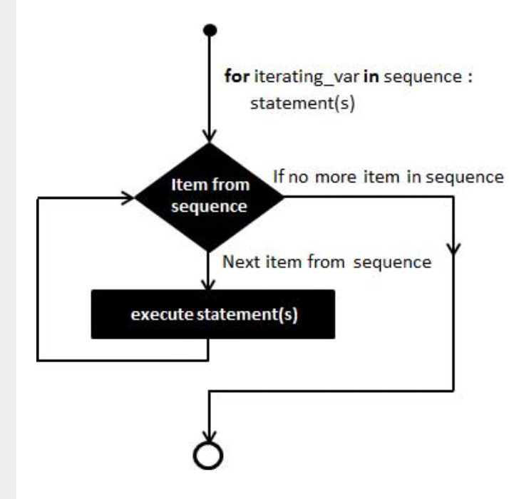

Slide 6
Syntax
for (initialization; condition; increment){ code to be executed; }

Slide 7
Example The following example makes five iterations and changes the assigned value of two variables on each pass of the loop −

Slide 8
<html> <body> <?php $a = 0; $b = 0; for( $i = 0; $i<5; $i++ ) { $a += 10; $b += 5; } echo ("At the end of the loop a = $a and b = $b" ); ?> </body> </html>

Slide 9
The while loop statement The while statement will execute a block of code if and as long as a test expression is true. If the test expression is true then the code block will be executed. After the code has executed the test expression will again be evaluated and the loop will continue until the test expression is found to be false.

Slide 10
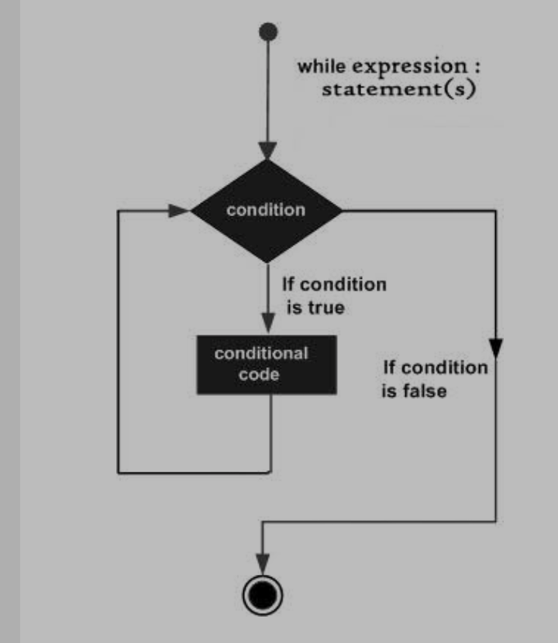

Slide 11
Syntax
while (condition) { code to be executed; }

Slide 12
Example
This example decrements a variable value on each iteration of the loop and the counter increments until it reaches 10 when the evaluation is false and the loop ends.

Slide 13
<html> <body> <?php $i = 0; $num = 50; while( $i < 10) { $num--; $i++; } echo ("Loop stopped at i = $i and num = $num" ); ?> </body> </html>

Slide 14
The do...while loop statement The do...while statement will execute a block of code at least once - it then will repeat the loop as long as a condition is true.

Slide 15
Syntax
do { code to be executed; } while (condition);

Slide 16
Example
The following example will increment the value of i at least once, and it will continue incrementing the variable i as long as it has a value of less than 10 −

Slide 17
html> <body> <?php $i = 0; $num = 0; do { $i++; } while( $i < 10 ); echo ("Loop stopped at i = $i" ); ?> </body> </html>

Slide 18
The foreach loop statement The foreach statement is used to loop through arrays. For each pass the value of the current array element is assigned to $value and the array pointer is moved by one and in the next pass next element will be processed.

Slide 19
Syntax
foreach (array as value) { code to be executed; }

Slide 20
Example
Try out following example to list out the values of an array.

Slide 21
<html> <body> <?php $array = array( 1, 2, 3, 4, 5); foreach( $array as $value ) { echo "Value is $value <br />"; } ?> </body> </html>

Slide 22
The break statement The PHP break keyword is used to terminate the execution of a loop prematurely. The break statement is situated inside the statement block. It gives you full control and whenever you want to exit from the loop you can come out. After coming out of a loop immediate statement to the loop will be executed

Slide 23
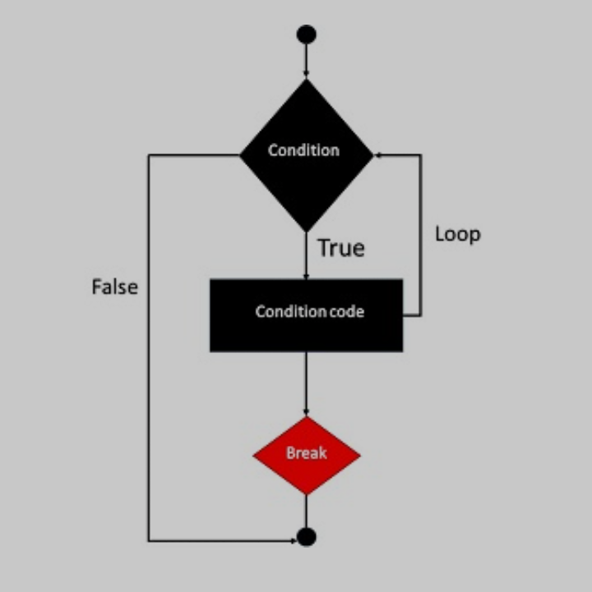

Slide 24
THANK YOU !

Slide 25
Example In the following example condition test becomes true when the counter value reaches 3 and loop terminates.

Slide 26
<html> <body> <?php $i = 0; while( $i < 10) { $i++; if( $i == 3 )break; } echo ("Loop stopped at i = $i" ); ?> </body> </html>

